Slide 1

Chapter 1
S/W Quality Management

Slide 2
What is S/W Quality
Definition
  IEEE : 주어진 요구사항을 만족시킬 수 있는 S/W의 기능 및 특성
  ISO/IEC 9126 : 명시적이거나 묵시적인 필요를 만족시키는 능력과 관련된 소프트웨어 제품의 특성 및 특징의 전체
  일반적 : 주어진 요구사항을 만족시킬 수 있는 능력을 가지는 S/W 제품의 특성과 특징의 총체
  Simplistically means that a product should meet its specification

Slide 3
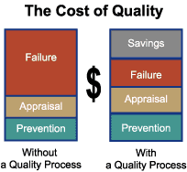
problem for software systems
  Tension between customer quality requirements (efficiency, reliability, etc.) and developer quality requirements (maintainability, reusablity, etc.)
  Some quality requirements are difficult to specify in an unambiguous way
  Software specifications
  are usually incomplete
  and often inconsistent

Slide 4
What is S/W Quality Managment
Definition
  Managing the quality of the software process and products
  Concerned with ensuring that the required level of quality is achieved in a software product
  Involves defining appropriate quality standards and procedures and ensuring that these are followed
  aim to develop a ‘quality culture’ where quality is seen as everyone’s responsibility
Object
  양질의 소프트웨어를 확보하여 시스템의 안전성과 신뢰성 향상
  유지보수 노력을 최소화하여 경제성 향상

Slide 5
The quality compromise
  We cannot wait for specifications to improve before paying attention to quality management
  Must put procedures into place to improve quality in spite of imperfect specification
  Quality management is therefore not just concerned with reducing defects but also with other product qualities
Quality Management Access Method
  프로세스 관점 접근
    CMM, SPICE, ISO 9000-3
  프로덕트 관점 접근
    ISO/IEC 12119, ISO/IEC 9126, ISO/IEC 14598

Slide 6
Software Quality Management Relationship
Quality Management = Total Quality Management
  S/W 생명주기 기간 활동 + 산출물에 대한 품질통제와 제어
  소프트웨어 품질에 대한 정의 인식 + 사용자 및 개발자
  측면에서 품질의 특성을 고려하여 관리
= Quality Control + Quality Assurance

Slide 7
Quality Control
개발, 운영 및 유지보수 과정
에서 S/W 품질유지를 위한
기본 프로세스
S/W 개발, 운영 및 유지보수
조직내에서 자체적 수행
결함감소에 의한 생상성 향상 및 불량감소 목표
Quality Assurance
S/W 신뢰성 보장을 위한
지원 프로세스
제3자의 입장에서 수행
결함발생의 사전방지를 위한
시정 및 예방조치 제도화

Slide 8
품질관리 및 경영
  품질통제와 품질보증의 유기적 연계 운영과 상호보완적
  관리 활동
  프로젝트의 비용과 스케줄링에 목표를 두고 실행
  모든 팀원이 integrity, product quality를 유지 관리
  Projected-quality staffing은 QA팀 수준 유지
  Quality management should be separate from project management to ensure independence

Slide 9
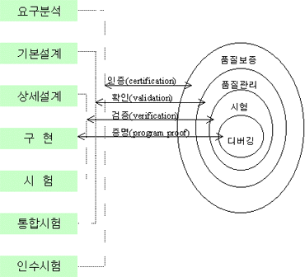
Quality Management & Development Proess
S/W Quality Relationship

Slide 10
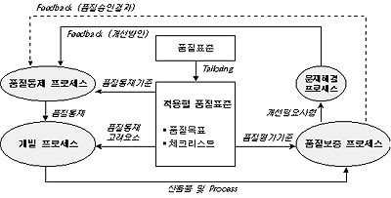
  개발 프로세스 : S/W 생명주기중 품질관리와 가장 직접적 관련
  상호간의 피드백을 통하여 계속적인 S/W 품질향상 추구

Slide 11
소프트웨어 생명주기 단계별 관리
  소프트웨어 개발 초기 : 프로젝트 특성과 품질 요구사항을 파악하여 품질목표 설정
  개발단계 : 품질목표의 충족여부 점검

Slide 12
Software Quality Attribute
S/W Quality characteristics in ISO/IEC 9126
Software quality
Functionality
Suitability, Accuracy, Interoperability, Security
Reliability
Maturity, Fault tolerance, Recoverability
Usability
Understandability, Learnability, Operability
Efficiency
Time behavior, Resource behavior
Maintainability
Analysability, Changeability, Testability
Portability
Analysability, Changeability, Testability

Slide 13
S/W Quality Management Principles
ISO/TC 176(Quality Management and Quality assurance)
  a) Provide a clear statement of the eight Quality Management Principles (QMP's) and place them in a business environment/framework
  b) Provide executive management with an understanding of the benefits for their organisation when using the QMP's.
  c) Provide an understanding of the QMP's that will facilitate a successful management culture for users of the ISO9000 Family of standards.

Slide 14
S/W Quality Management Principles
Principle 1 Customer focus
Organizations depend on their customers and therefore should understand current and future customer needs, meet customer requirements, and strive to exceed customer expectations.
Principle 2 Leadership
Leaders establish unity of purpose and direction of organization. They should create and maintain the internal environment in which people can become fully involved in achieving the organization's objectives.

Slide 15
S/W Quality Management Principles
Principle 3 Involvement of people
People at all levels are the essence of an organization and their full involvement enables their abilities to be used for the organization's benefit.
Principle 4 Process approach
A desired result is achieved more efficiently when related resources and activities are managed as a process.
Principle 5 System approach to management
Identifying, understanding, and managing a system of interrelated processes for a given objective improves the organization's effectiveness and efficiency.

Slide 16
S/W Quality Management Principles
Principle 6 Continual improvement
Continual improvement should be a permanent objective of the organization.
Principle 7 Factual approach to decision making
Effective decisions and actions are based on the analysis of data and information.
Principle 8 Mutually beneficial supplier relationships
An organization and its suppliers are independent, and a mutually beneficial relationship enhances the ability to create value.

